Slide 1
NVEST
General Ledger Accounting for Investment Management Activity
Workshop
September 16, 2014

Slide 2
Agenda
State of South Carolina General Ledger Accounting Process for Investment Management Activity Overview
  SCEIS / STO terminology
General Ledger Accounting Process flow / transactions for Investment Management Activity
  Generate end-to-end flow for General Ledger Accounting - Investment Management Activity
  Preliminary Process Steps

Slide 3

Accounting Process – (Investment Management Activity)
To review the STO Accounting Process for the Investment Management Division requirements and processes against SAP system’s functionality for the following topic areas…..
Account Assignment Reference
General Valuation Class
Valuation Class
Valuation Area
Fund
Transfers
  Fund Transfer
  Portfolio Transfer
  Account assignment transfer
  Securities Account Transfer
Company Code
Accounting Code
Purchase of Investment
Sale of Investment
Maturities of Investment
Interest receipt on Investments
Bank reconciliation
In order to complete the objectives of a Blueprint Workshop.
Accounting process scenarios we are missing (document throughout the work session)??

Slide 4
Accounting Process – (Investment Management)
To review the STO Accounting Process for the Investment Management Division requirements and processes against SAP system’s functionality for the following topic areas…..
Closing
Interest Income Accrual
  Difference Procedure
  Reset Procedure
Amortization
  Valuation with Reset
  Valuation without Reset
Income Sweep
Market Valuation
  Market value with reset
  Market value without reset
Realized Gain/Loss
Reversals & Corrections
Reporting
In order to complete the objectives of a Blueprint Workshop.
Accounting process scenarios we are missing (document throughout the work session)??

Slide 5
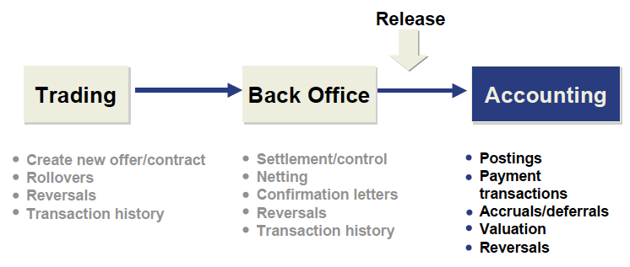
Transaction Overview

Slide 6
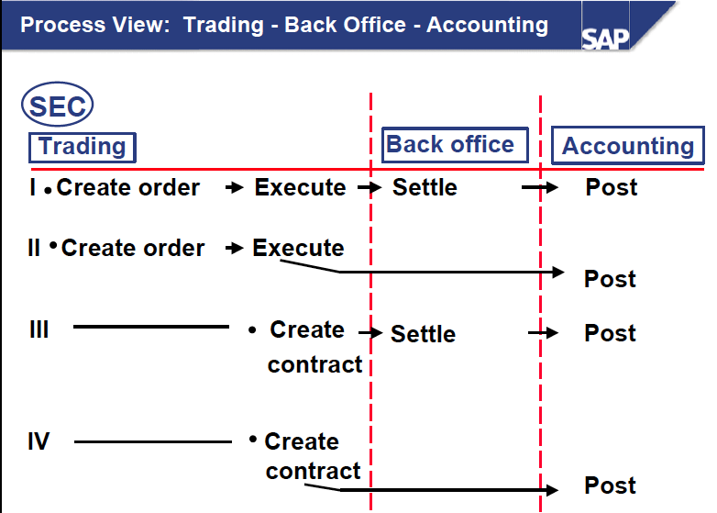
Process View

Slide 7
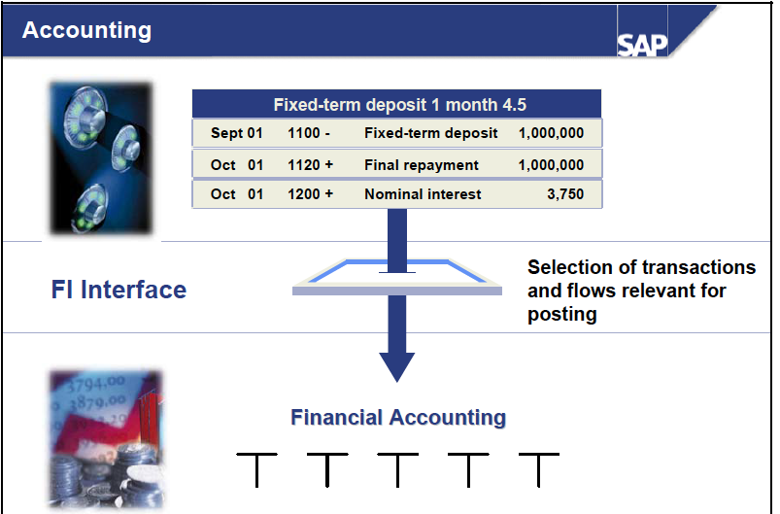
Posting Logic

Slide 8
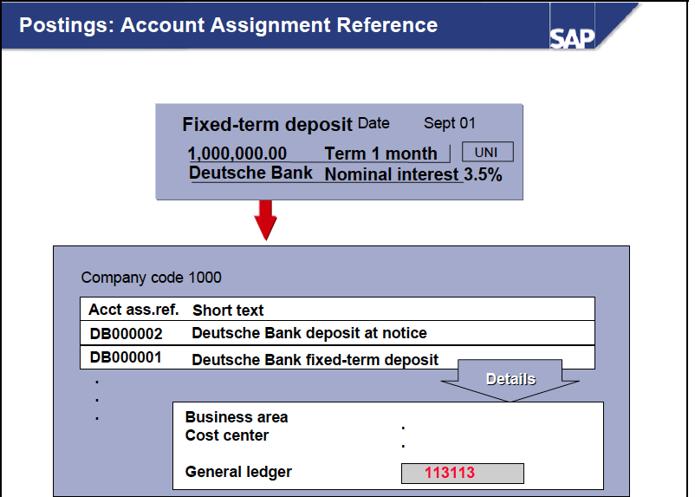
Account Assignment Reference

Slide 9
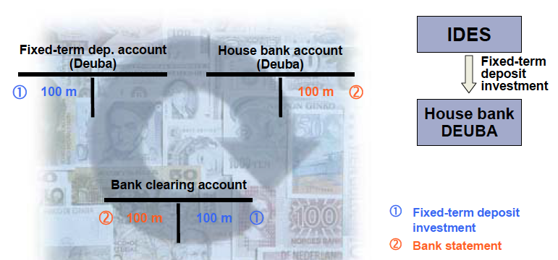
Payment with clearing account

Slide 10
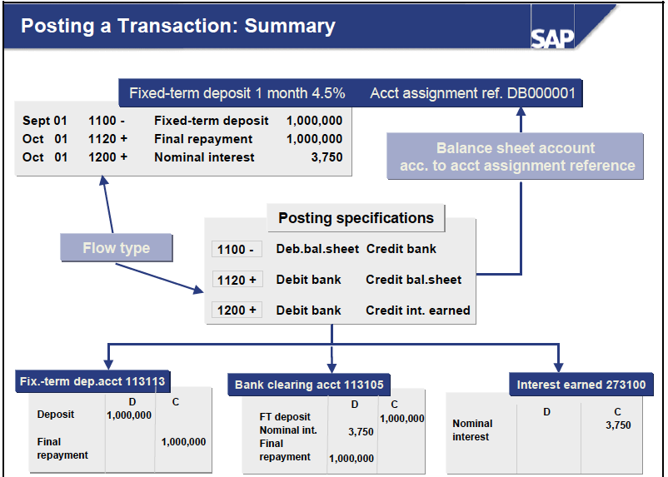
Posting Summary

Slide 11
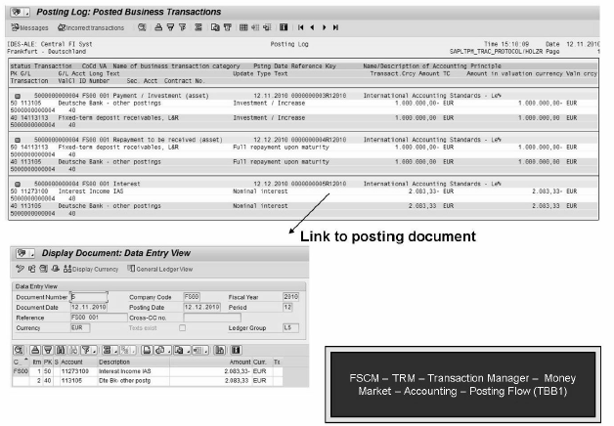
Posting Log

Slide 12
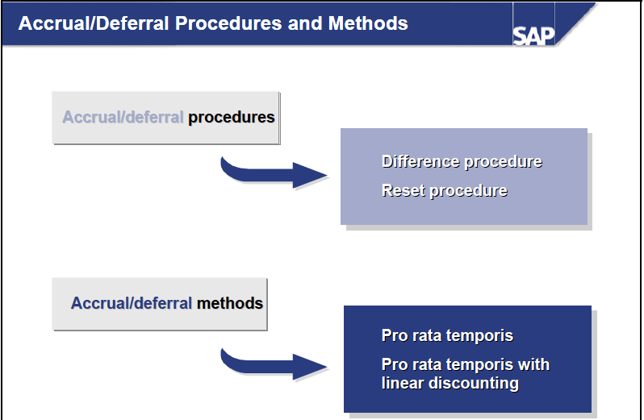
Accrual Procedures

Slide 13
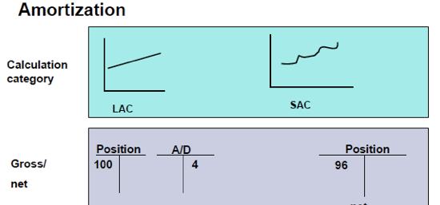
Amortization

Slide 14
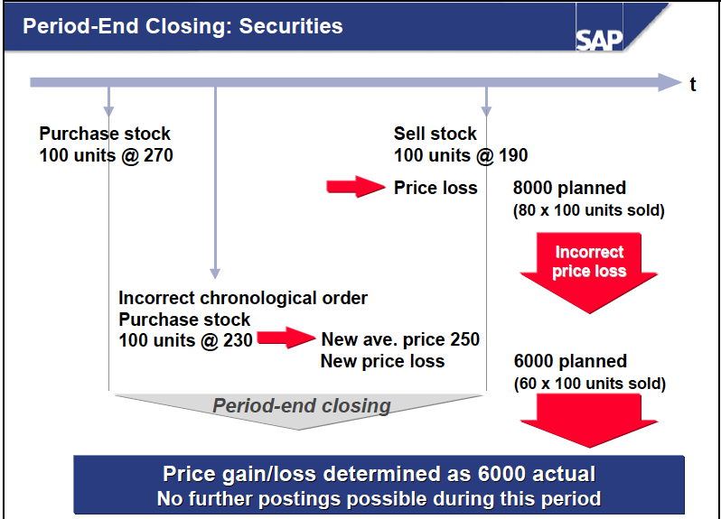
Period End Closing

Slide 15
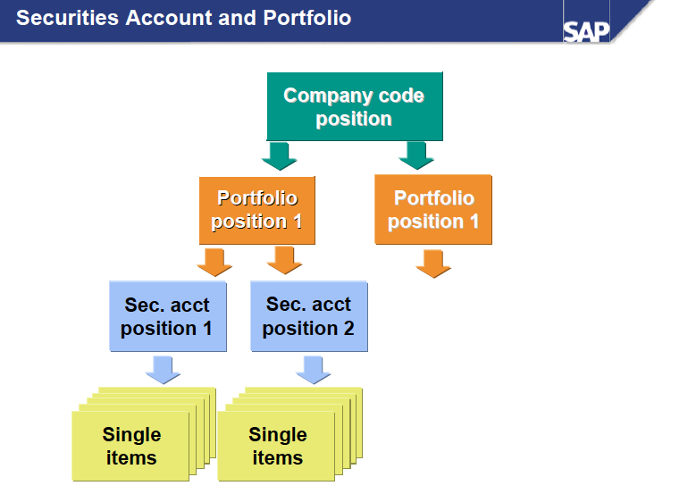
Organizational & Valuation Structure

Slide 16
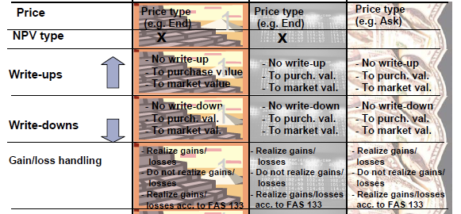
Valuation

Slide 17
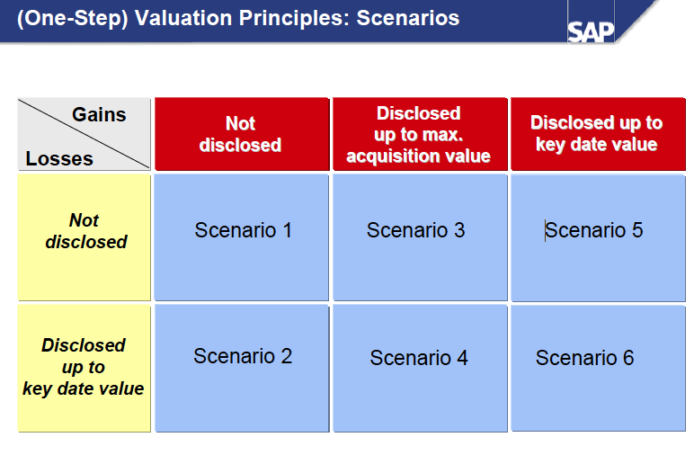
Valuation

Slide 18
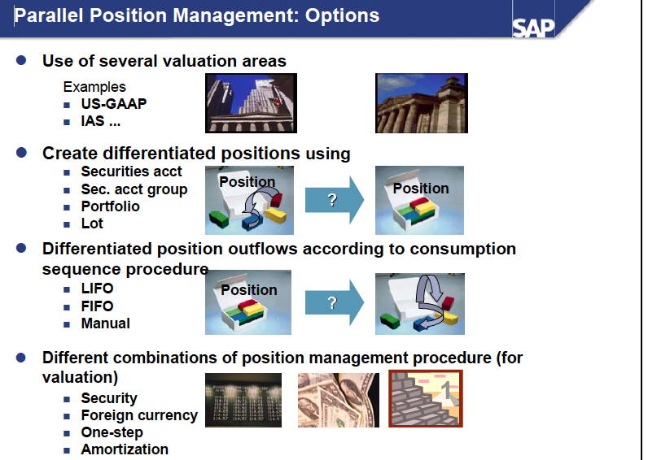
Valuation Areas

Slide 19
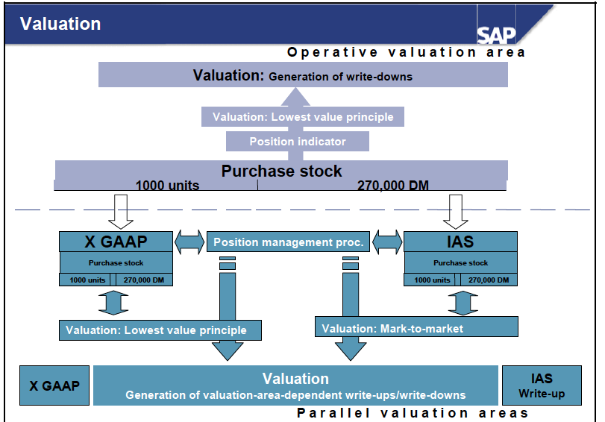
Valuation Areas II

Slide 20

Agenda
State of South Carolina General Ledger Accounting Process for Investment Management Activity Overview
  SCEIS / STO terminology
General Ledger Accounting Process flow / transactions for Investment Management Activity
  Generate end-to-end flow for General Ledger Accounting - Investment Management Activity
  Preliminary Process Steps

Slide 21
Accounting Investments Process Flow
Flow Investments process
Document triggers, manual steps, approval steps, system steps (SAP & non-sap)
Align responsibility to step (role / department)
Identify SAP transactions which support the STO Investment Management Accounting Process
Create – Change – Display - Retire processes
Ancillary system feeds (←→) (Automated / Manual )
Various Investment Management Accounting Scenarios
  Post Investment purchase
  Post Investment sale/maturity
  Post Interest Receipt
  Post Interest accrual
  Post Amortization
  Post Valuation
  Post Income Sweep
  Accounting Postings
  Reporting

Slide 22
Agenda
State of South Carolina General Ledger Accounting Process for Investment Management Activity Overview
  SCEIS / STO terminology
General Ledger Accounting Process flow / transactions for Investment Management Activity
  Generate end-to-end flow for General Ledger Accounting - Investment Management Activity
  Preliminary Process Steps

Slide 23
Closure
Assignment of
  Next steps
  Open issues
  Actions
  With ‘what’, ‘when’ and ‘who’
Create and place documentation of decisions made in shared file folders
Issues meeting minutes / output to participants

Slide 24
End

